Slide 1


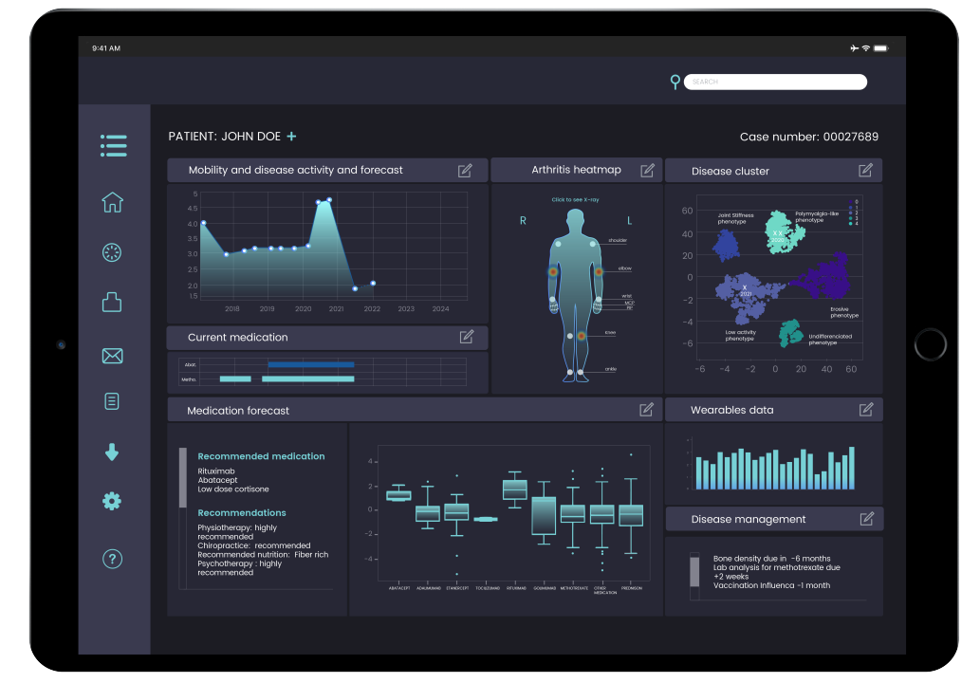
An In-Depth Case Study Analysis of the Abuse of AI in Early Sepsis Detection
Notes:
This presentation summarizes the implementation, benefits, challenges, and ethical implications of AI-based sepsis detection systems.

Slide 2
What is Sepsis?
The Silent Killer: Sepsis is an extreme immune overreaction to infection that attacks the body’s own organs.
The Time Factor: Every hour treatment is delayed, the risk of death increases by 4% to 8%.
The Diagnostic Gap: Early symptoms are mundane (fever, fatigue) and easy to miss in busy hospital environments.• High mortality if untreated
Notes:
Sepsis progresses rapidly. Early detection dramatically improves survival rates.

Slide 3
AI Technology Used
Supervised Learning: AI is trained on millions of historical patient records to identify patterns that precede a sepsis diagnosis.
Personalization: Unlike traditional alarms, AI evaluates patients against their own personal physiological baselines.
The Silent Sentinel: Algorithms run in the background, constantly calculating risk scores and alerting clinicians only when thresholds are crossed.
Notes:
The AI continuously analyzes patient data and assigns risk scores.

Slide 4
Implementation
Data Integrity: Hospital data is often "messy," full of gaps, and not originally designed for AI analysis.
The Threshold Dilemma: * Low Threshold: Leads to "alert fatigue," where nurses ignore warnings due to constant false positives.
High Threshold: Increases specificity but risks missing deteriorating patients entirely.
Solution: Continuous feedback loops between clinicians and developers to build trust and accuracy.
Notes:
Implementation required workflow integration and clinician training.

Slide 5
Benefits
Early Intervention: Catching sepsis early allows for antibiotics and fluids to start hours sooner, which significantly improves survival odds and reduces long-term complications like organ damage.
Reduced Cognitive Load: The AI acts as an extra pair of "tired eyes that never get tired," helping clinicians prioritize patients and reducing the chronic stress of constant vigilance.
Operational Efficiency: Early detection leads to shorter hospital stays and less time on ventilators, freeing up critical bed capacity and lowering the cost of care.
Notes:
Studies show earlier intervention reduces complications and hospital stays.

Slide 6
Challenges
Messy Data: Hospital data is often inconsistent, full of gaps, and collected for billing rather than clean machine learning analysis.
Alert Fatigue: If the alert threshold is set too low, the system produces frequent false positives, leading nurses to ignore or mute warnings.
Sensitivity vs. Specificity: Finding the "sweet spot" to ensure the system catches real deterioration without generating excessive noise is an ongoing struggle.
Notes:
Alert fatigue and transparency are major limitations.

Slide 7
Ethical Considerations
Algorithmic Bias: Because AI is a reflection of its training data, if historical data lacks diversity, the algorithm may perform poorly for Black or Hispanic patients, baking past inequities into future care.
The "Black Box" Problem: Some powerful models are too complex for creators to explain, making it difficult for physicians to provide a defensible medical rationale to families for life-or-death decisions.
Trust and Autonomy: The system must be viewed as a "partnership" rather than a replacement for clinical judgment to avoid eroding the expertise of human healers.
Notes:
Ethical frameworks help evaluate fairness and accountability.

Slide 8
Societal Impact
Widening Health Disparities: The high cost of implementing and maintaining these systems could create a "digital divide," where well-funded academic centers offer a higher safety net than rural or safety-net hospitals.
Human-Centered Care: On a positive note, when clinicians trust the AI to monitor physiological data, they can focus more on the human aspects of care, such as providing comfort and talking with families.
Access inequality
Notes:
Both positive and negative societal consequences must be considered.

Slide 9


Future Trends
Explainable AI (XAI): There is a growing research trend toward creating models that provide a human-understandable rationale for their alerts (e.g., explaining that an alert was triggered by a specific drop in blood pressure and rising lactate levels).
Integration of Unstructured Data: Future systems aim to better incorporate "heterogeneous" data, such as a nurse's qualitative notes about a patient's confusion.
• Wearables
• Personalized medicine
Notes:
Healthcare AI will likely become more transparent and personalized.

Slide 10
Conclusion
Augmentation, Not Replacement: AI should act as a digital watchdog that "whispers" to clinicians, rather than a replacement for human judgment.
Moral Imperative: Using AI wisely requires regular fairness audits and a c
To give every patient a fighting chance through a partnership of human empathy and machine vigilance.
Notes:
Responsible AI implementation ensures long-term benefits.

Slide 11
Example Impact: Mortality Reduction

